Slide 1
Classification: Basic Concepts
P. Krishna Reddy, IIIT Hyderabad

Slide 2
Detailed Syllabus
Introduction (1.5 hour): Definition, KDD framework, Issues in data mining.
Data summarization (7.5 hrs): Data Types, Preprocessing, Characterization, Discrimination, data warehousing techniques (Multidimensional data model, Data warehousing architecture, Data cube computation and OLAP technology)
Mining patterns and associations (9 hours) Introduction to Association mining, a priori algorithm, FP growth, ECLAT, Overview of other algorithms, Pattern Evaluation, Coverage pattern mining, Multi-level mining, Quantitative association rules, Utility mining, Diverse Patterns, Coverage Patterns
Classification and regression (9hrs) (Overview, Decision tree induction, Over-fitting and under-fitting, Scalable decision tree algorithms, Bayesian Classification, Regression-based Prediction methods (9 hours)
Concepts and algorithms for clustering the data (9 hours) (Overview, Types of Data, K-means, Aglomerative clustering, Clustering algorithms (DBSCAN, BIRCH, CURE, ROCK, CHAMELEON)).
Outlier analysis and future trends (graph mining, spatio-temporal mining). (3 hours)

Slide 3
Presentation Outline
Background
Basic concepts
Decision Tree Induction
Bayes Classification Methods
Lazy Learners (k-nearest neighbours)
Linear Classifiers
Model Evaluation and Selection
Techniques to Improve Accuracy
Summary

Slide 4
A simple question
1, 3, 5, 7, 9, …. What is the next number?
Ans: 11. ; Odd numbers, Or 2n+1
1, 3, 9, 19, 33, ... What is the next number?
Ans: 51; 2n²+1
How do we solve such problems?
Find a pattern from the examples.
(function f(n) = 2n+1. Or model the data)
Use it to predict the next number (or solve the problem)
How do we design a computational procedure?

Slide 5
A simple question (cont.)
We know: 1, 3, 9, 19, 33, ... What is the next number?
Ans: 51; 2n²+1
0.99, 3.02, 9.00, 18.98, 33.01, ... What next?
Consider a series of 2D points
(1,3), (2,6), (3,9), (4,12), ....
What is the next point?
When does the problem become difficult?
When numbers are “uncertain”. Noise in measurements
When numbers are not just “simple numbers”?

Slide 6
Traditional Programming
Machine Learning
Data
Computer
Output
Program
Data
Computer
Program
Output

Slide 7



The machine learning framework
Apply a prediction function to a feature representation of the “sample” to get the desired output:
f( ) = “apple”
f( ) = “tomato”
f( ) = “cow”
Slide credit: L. Lazebnik

Slide 8
The machine learning/Classification framework
y = f(x)
Training: given a training set of labeled examples {(x₁,y₁), …, (x_{N},y_{N})}, estimate the prediction function f by minimizing the prediction error.
Testing: apply f to a never before seen test example x and output the predicted value y = f(x)
output
prediction function
feature or
representation
Slide credit: L. Lazebnik

Slide 9
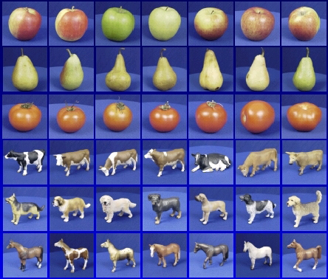

Steps
Training
Training Labels
Training Data
Features
Training
Learned model
Testing
Features
Learned model
Prediction
Test sample

Slide 10
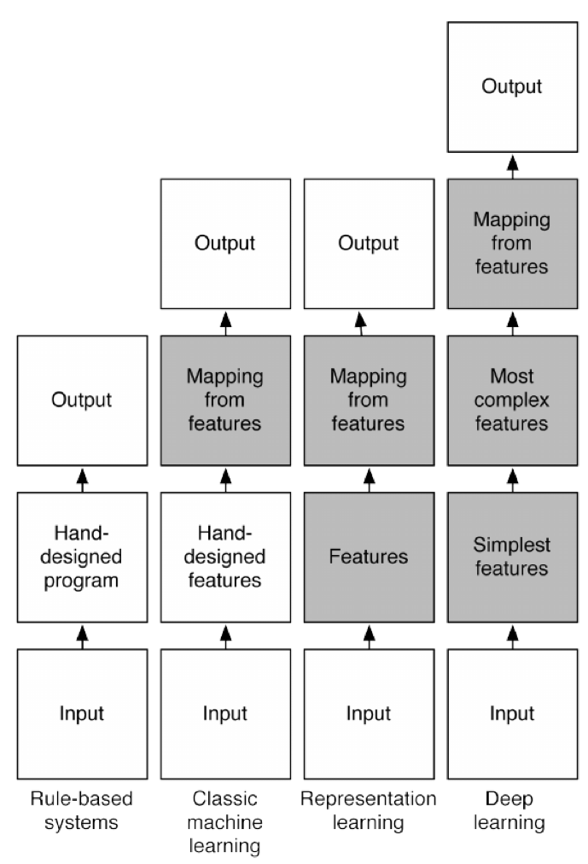
What is deep learning?
Y. Bengio et al, ``Deep Learning”, MIT Press, 2015

Slide 11
Presentation Outline
Background
Basic concepts
Decision Tree Induction
Bayes Classification Methods
Lazy Learners (k-nearest neighbours)
Linear Classifiers
Model Evaluation and Selection
Techniques to Improve Accuracy
Summary

Slide 12
Classification: Definition
Given a collection of records (training set )
Each record contains a set of attributes, one of the attributes is the class.
Find a model for class attribute as a function of the values of other attributes.
Goal: previously unseen records should be assigned a class as accurately as possible.
A test set is used to determine the accuracy of the model. Usually, the given data set is divided into training and test sets, with training set used to build the model and test set used to validate it.

Slide 13
Illustrating Classification Task

Slide 14
Supervised vs. Unsupervised Learning
Supervised learning (classification)
Supervision: The training data (observations, measurements, etc.) are accompanied by labels indicating the class of the observations
New data is classified based on the training set
Unsupervised learning (clustering)
The class labels of training data is unknown
Given a set of measurements, observations, etc. with the aim of establishing the existence of classes or clusters in the data

Slide 15
Classification vs. Prediction
Classification
predicts categorical class labels (discrete or nominal)
classifies data (constructs a model) based on the training set and the values (class labels) in a classifying attribute and uses it in classifying new data
Prediction
models continuous-valued functions, i.e., predicts unknown or missing values
Typical applications
Credit/loan approval:
Medical diagnosis: if a tumor is cancerous or benign
Fraud detection: if a transaction is fraudulent
Web page categorization: which category it is

Slide 16
Classification—A Two-Step Process
Model construction: describing a set of predetermined classes
Each tuple/sample is assumed to belong to a predefined class, as determined by the class label attribute
The set of tuples used for model construction is training set
The model is represented as classification rules, decision trees, or mathematical formulae
Model usage: for classifying future or unknown objects
Estimate accuracy of the model
The known label of test sample is compared with the classified result from the model
Accuracy rate is the percentage of test set samples that are correctly classified by the model
Test set is independent of training set, otherwise over-fitting will occur
If the accuracy is acceptable, use the model to classify data tuples whose class labels are not known

Slide 17
Process (1): Model Construction
Classification
Algorithms
Training
Data
Classifier
(Model)
IF rank = ‘professor’
OR years > 6
THEN tenured = ‘yes’

Slide 18
Process (2): Using the Model in Prediction
Classifier
Testing
Data
Unseen Data
(Jeff, Professor, 4)
Tenured?

Slide 19
Classification Issues: Data Preparation
Data cleaning
Preprocess data in order to reduce noise and handle missing values
Relevance analysis (feature selection)
Remove the irrelevant or redundant attributes
Data transformation
Generalize and/or normalize data

Slide 20
Issues: Evaluating Classification Methods
Estimate accuracy of the model
The known label of test sample is compared with the classified result from the model
Accuracy rate is the percentage of test set samples that are correctly classified by the model
Test set is independent of training set (otherwise overfitting)
If the accuracy is acceptable, use the model to classify new data
Note: If the test set is used to select models, it is called validation (test) set

Slide 21
Presentation Outline
Background
Basic concepts
Decision Tree Induction
Bayes Classification Methods
Rule-Based Classification
Model Evaluation and Selection
Techniques to Improve Accuracy
Summary

Slide 22
Decision tree induction
Decision tree induction is the learning of decision trees from class-labeled training tuples.
A decision tree is a flowchart-like tree structure
Each internal node (nonleaf node) denotes a test on an attribute,
Each branch represents an outcome of the test
Each leaf node (or terminal node) holds a class label.
Root node is the topmost node.

Slide 23
Decision Tree Induction: An Example
Training data set: Buys_computer
The data set follows an example of Quinlan’s ID3
Resulting tree:
age?
<=30
overcast
>40
31..40
student?
yes
credit rating?
no
yes
excellent
fair
no
yes
no
yes

Slide 24
Use of decision tree
For a tuple X, the attribute values are tested against the decision tree.
A path is traced from the root to leaf.
Reason for popularity
Easy to construct, simple and fast
No domain knowledge is required
Easy to understand; interpretable
They can handle multidimensional data
Good accuracy
Several applications

Slide 25
History
Introduced by J.Ross Quinlan
Developed ID3 algorithm (Iterative Dichotomiser)
Quinlan also presented C4.5 which became a benchmark
A CART algorithm is published a four researchers independently
Three algorithms: ID3, C4.5, and CART adopt a greedy approach (non-backtracking)
Top-down, divide and conquer

Slide 26
Algorithm for Decision Tree Induction
Basic algorithm (a greedy algorithm)
Tree is constructed in a top-down recursive divide-and-conquer manner
At start, all the training examples are at the root
Attributes are categorical (if continuous-valued, they are discretized in advance)
Examples are partitioned recursively based on selected attributes
Test attributes are selected on the basis of a heuristic or statistical measure (e.g., information gain)
Conditions for stopping partitioning
All samples for a given node belong to the same class
There are no remaining attributes for further partitioning – majority voting is employed for classifying the leaf
There are no samples left

Slide 27
Inputs: D, attribute list, and attribute selection method
D is the complete set of training tuples and associated class lablels
Attribute list: list of attributes describing the tuples
Attribute selection method specifies the method to select the attributes.

Slide 28
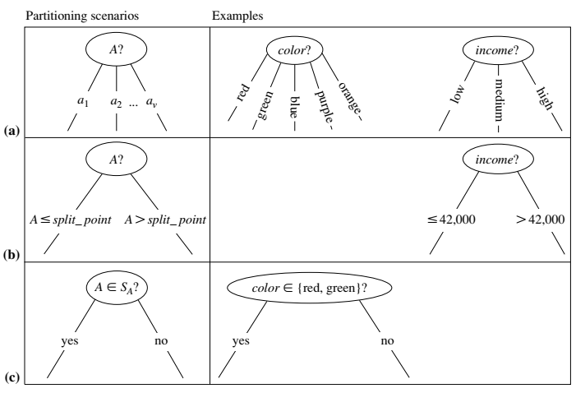
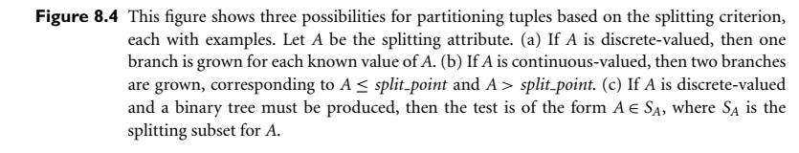
Splitting possibilities

Slide 29
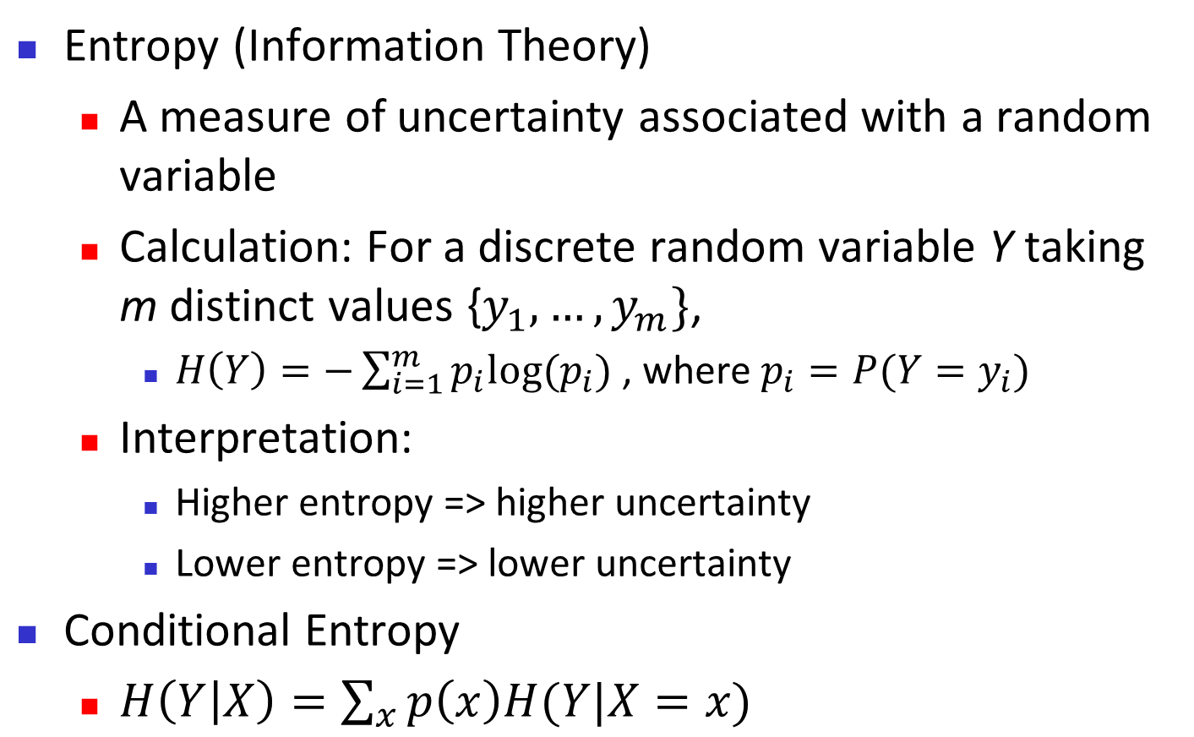
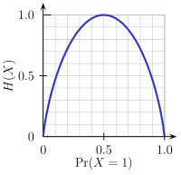
Brief Review of Entropy
m = 2

Slide 30
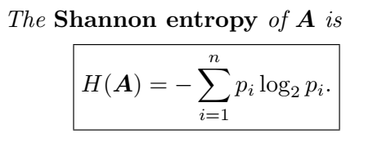
About Shannon’s entropy
Consider transmission of a1, a2, a3, a4
Option 1: a1= 00, a2=01, a3=10, a4= 11
Option 2: a1=0, a2=10, a3=110, a4=111
(i) Option 1: If p(a1)=p(a2)=p(a3)=p(a4)=1/4
Expected code length= 2 bits.
Option 2: Expected code length=2.25 bits
(ii) If p(a1)= 1/2; p(a2)=1/4; p(a3)=1/8; p(a4)=1/8
Option 1: 2 bits (if we do not consider probabilities)
Option 2= 1.75 bits =(-1/2*log(1/2) -1/4*log(1/4)-1/8*log(1/8)-1/8*log(1/8)=1/2+2/4+ 3/8+3/8=1.75
(Equal to Shannon’s entropy)
The idea is that frequent letters should be coded with smaller length.
pi= probability of event X
log(pi) is the amount of information of event x
Information content of event x with probability p=log(1/p(x))=-log(p(x))

Slide 31
Attribute Selection Measure: Information Gain (ID3/C4.5)
Select the attribute with the highest information gain
Let p_{i} be the probability that an arbitrary tuple in D belongs to class C_{i}, estimated by |C_{i, D}|/|D|
Expected information (entropy) needed to classify a tuple in D:
Information needed (after using A to split D into v partitions) to classify D:
Information gained by branching on attribute A
Notes:
I : the expected information needed to classify a given sample
E (entropy) : expected information based on the partitioning into subsets by A

Slide 32
Attribute Selection: Information Gain
Class P: buys_computer = “yes”
Class N: buys_computer = “no”
means “age <=30” has 5 out of 14 samples, with 2 yes’es and 3 no’s. Hence
Similarly,

Slide 33
Computing Information-Gain for Continuous-Valued Attributes
Let attribute A be a continuous-valued attribute
Must determine the best split point for A
Sort the value A in increasing order
Typically, the midpoint between each pair of adjacent values is considered as a possible split point
(a_{i}+a_{i+1})/2 is the midpoint between the values of a_{i} and a_{i+1}
The point with the minimum expected information requirement for A is selected as the split-point for A
Split:
D1 is the set of tuples in D satisfying A ≤ split-point, and D2 is the set of tuples in D satisfying A > split-point

Slide 34
Gain Ratio for Attribute Selection (C4.5)
Information gain measure is biased towards attributes with a large number of values
C4.5 (a successor of ID3) uses gain ratio to overcome the problem (normalization to information gain)
GainRatio(A) = Gain(A)/SplitInfo(A)
Ex.
gain_ratio(income) = 0.029/1.557 = 0.019
The attribute with the maximum gain ratio is selected as the splitting attribute

Slide 35
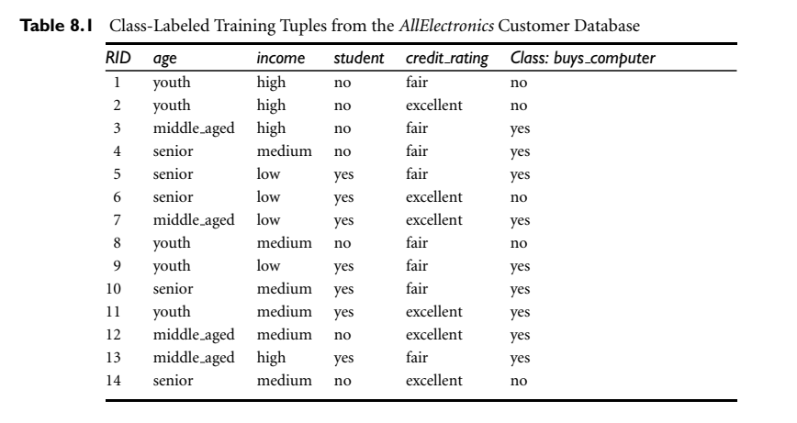
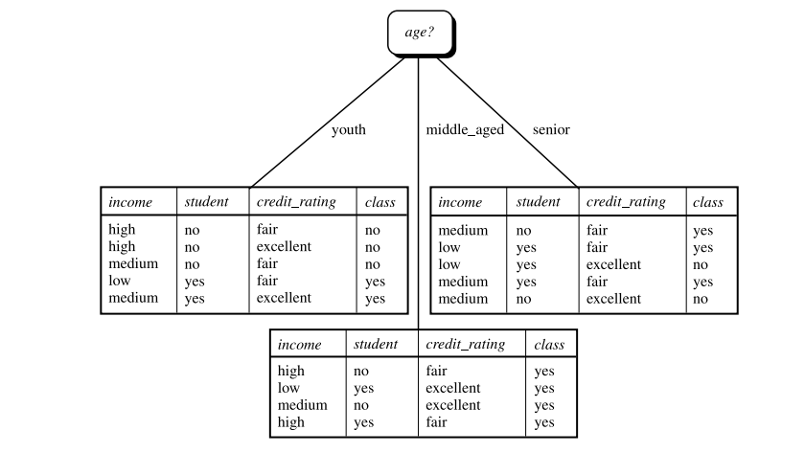

Slide 36
Gini Index (CART, IBM IntelligentMiner)
If a data set D contains examples from n classes, gini index, gini(D) is defined as
where p_{j} is the relative frequency of class j in D
If a data set D is split on A into two subsets D₁ and D₂, the gini index gini(D) is defined as
Reduction in Impurity:
The attribute provides the smallest gini_{split}(D) (or the largest reduction in impurity) is chosen to split the node (need to enumerate all the possible splitting points for each attribute)

Slide 37
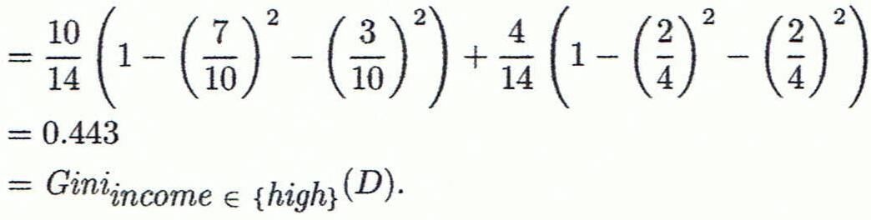
Computation of Gini Index
Ex. D has 9 tuples in buys_computer = “yes” and 5 in “no”
Suppose the attribute income partitions D into 10 in D₁: {low, medium} and 4 in D₂
Gini_{{low,high}} is 0.458; Gini_{{medium,high}} is 0.450. Thus, split on the {low,medium} (and {high}) since it has the lowest Gini index
All attributes are assumed continuous-valued
May need other tools, e.g., clustering, to get the possible split values
Can be modified for categorical attributes

Slide 38
Comparing Attribute Selection Measures
The three measures, in general, return good results but
Information gain:
biased towards multivalued attributes
Gain ratio:
tends to prefer unbalanced splits in which one partition is much smaller than the others
Gini index:
biased to multivalued attributes
has difficulty when # of classes is large
tends to favor tests that result in equal-sized partitions and purity in both partitions

Slide 39
Other Attribute Selection Measures
CHAID: a popular decision tree algorithm, measure based on χ² test for independence
G-statistic: has a close approximation to χ² distribution
MDL (Minimal Description Length) principle (i.e., the simplest solution is preferred):
The best tree as the one that requires the fewest # of bits to both (1) encode the tree, and (2) encode the exceptions to the tree
Multivariate splits (partition based on multiple variable combinations)
CART: finds multivariate splits based on a linear comb. of attrs.
Which attribute selection measure is the best?
Most give good results, none is significantly superior than others

Slide 40
Enhancements to Basic Decision Tree Induction
Allow for continuous-valued attributes
Dynamically define new discrete-valued attributes that partition the continuous attribute value into a discrete set of intervals
Handle missing attribute values
Assign the most common value of the attribute
Assign probability to each of the possible values
Attribute construction
Create new attributes based on existing ones that are sparsely represented
This reduces fragmentation, repetition, and replication

Slide 41
Underfitting and Overfitting
Underfitting and overfitting are two problems that will adversely affect the accuracy and usefulness of the model.
Classification requires three data sets
Training data set
This is the data that are analyzed to first produce a model.
Test data set
Once a model is developed it is then tested on the evaluation data set. The second data set is an evaluation data set important for refining the model if necessary, and to get a sense of how well the model will perform on subsequent data that it will be applied on.
Data on which classification is applied

Slide 42
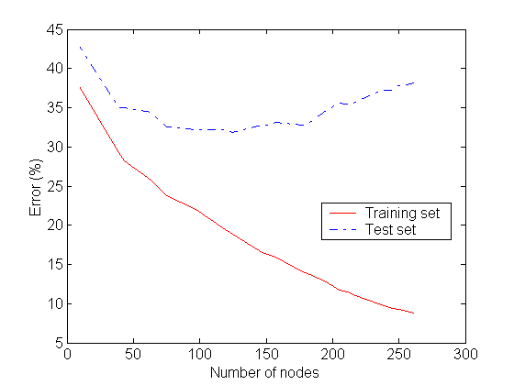
Underfitting and Overfitting
Underfitting
Overfitting
Underfitting: when model is too simple, both training and test errors are large
Overfitting: once the tree becomes too large, its test error rates begins to increase even though its training error rate continues to decrease.

Slide 43
Underfitting
Underfitting is a situation where training and test error rates of the model are large when the size of the tree is very small.
Underfiting occurs because the model has yet to learn the true structure of the data
It performs poorly on both training and test sets
As number of nodes in the decision tree increases the tree will have a fewer training and test errors.
However, once the tree becomes too large, its test error rates begins to increase even though its training error rate continues to decrease. It is called overfitting.

Slide 44
Underfitting
Underfitting refers to a model that is too general and fails to find interesting patterns in the data.
This can result from not including important variables as inputs during the model building process.
In terms of a loan application scenario, the analyst or model-builder may include annual salary as an important factor, but may exclude information about the applicant's job, which may turn out to be important.
For example, jobs that are seasonal (swimming pool maintenance, landscaping, etc.) may affect the person's ability to submit monthly payments during the times when work is slower -- information that is not reflected by their annual salary.
This might suggest that as much information as possible should be included as inputs during the model building process to avoid underfitting.

Slide 45
More on Underfitting
Training error can be reduced by increasing the model complexity.
Leaf-nodes can be expanded until it perfectly fits the training data.
As a result the test error may be large because the tree may fit some of the noise points in the data.
Such nodes degrade the performance as they do not generalize well to the test examples.

Slide 46
Overfitting
Overfitting: once the tree becomes too large, its test error rates begins to increase even though its training error rate continues to decrease.
Including as much information as possible to develop a model can lead to the problem of overfitting.
Overfitting refers to models that are too specific, or too sensitive to the particulars of the data (the training set) used to build the model.
This can be due to having too many variables used as inputs and/or a non-representative training set.
In the loan application scenario, if in the training set, many people that defaulted on their loans happened to be named "Smith" (a popular name), then the model (e.g. a decision tree) may decide that if the applicant's last name is "Smith", then deny the loan.
In refining the model, perhaps last name should not serve as an input. More importantly, the characteristics of the data used to build the model have to be representative of the data at large -- it's unlikely that people named Smith have a disproportionately high rate of defaulting on loans.

Slide 47
Overfitting
Overfitting can be corrected using the evaluation data set. If accurate performance on the training set is due to particular characteristics in that data (e.g. person's last name), then performance will be poor on the evaluation set as long as the evaluation set does not share these idiosyncrasies.
Refining the model (e.g. by pruning the decision tree) involves setting performance to be generally equivalent on both the training and evaluation data sets.
This will generally give the analyst the idea of how well the model may perform on "real" data.

Slide 48
Overfitting Examples
Overfitting can still occur despite the use of a training and evaluation data set.
This can be the result of poorly creating the training and evaluation sets -- so that neither is representative of subsequent data that the model will be applied to.
For example, of predicting stock market performance.
One year's worth of data were partitioned into equal sized training and evaluation sets. A quantitative model was developed based on the training set -- and its predictive power on this dataset was impressive. It was equally impressive on the evaluation dataset, apparently requiring no refinement. But when applied to the next year's data it performed miserably despite the fact that there were not significant events related to the stock market. The reason for this is had to do with how the training and evaluation data sets were created. The training and evaluation sets were based on the daily closing values of alternate days. Day 1's close was assigned to the training set, day 2 to the evaluation set, day 3 to the training set, day 4 to the evaluation set, and so forth. As a result the overfitting that occurred when the model picked up factors tied to the temporal fluctuations in the stock market's closing values were carried over into the evaluation set as well.

Slide 49
Overfitting and Tree Pruning
Overfitting: An induced tree may overfit the training data
Too many branches, some may reflect anomalies due to noise or outliers
Poor accuracy for unseen samples
Two approaches to avoid overfitting
Prepruning: Halt tree construction early ̵ do not split a node if this would result in the goodness measure falling below a threshold
Difficult to choose an appropriate threshold
Postpruning: Remove branches from a “fully grown” tree—get a sequence of progressively pruned trees
Use a set of data different from the training data to decide which is the “best pruned tree”

Slide 50
Classification in Large Databases
Classification—a classical problem extensively studied by statisticians and machine learning researchers
Scalability: Classifying data sets with millions of examples and hundreds of attributes with reasonable speed
Why is decision tree induction popular?
relatively faster learning speed (than other classification methods)
convertible to simple and easy to understand classification rules
can use SQL queries for accessing databases
comparable classification accuracy with other methods
RainForest (VLDB’98 — Gehrke, Ramakrishnan & Ganti)
Builds an AVC-list (attribute, value, class label)

Slide 51
Scalability Framework for RainForest
Separates the scalability aspects from the criteria that determine the quality of the tree
Builds an AVC-list: AVC (Attribute, Value, Class_label)
AVC-set (of an attribute X )
Projection of training dataset onto the attribute X and class label where counts of individual class label are aggregated
AVC-group (of a node n )
Set of AVC-sets of all predictor attributes at the node n

Slide 52
Rainforest: Training Set and Its AVC Sets
Training Examples
AVC-set on Age
AVC-set on income
Age | Buy_Computer
 | yes | no
<=30 | 2 | 3
31..40 | 4 | 0
>40 | 3 | 2
income | Buy_Computer
 | yes | no
high | 2 | 2
medium | 4 | 2
low | 3 | 1
AVC-set on
credit_rating
AVC-set on Student
student | Buy_Computer
 | yes | no
yes | 6 | 1
no | 3 | 4
Credit rating | Buy_Computer
 | yes | no
fair | 6 | 2
excellent | 3 | 3

Slide 53
BOAT (Bootstrapped Optimistic Algorithm for Tree Construction)
Use a statistical technique called bootstrapping to create several smaller samples (subsets), each fits in memory
Each subset is used to create a tree, resulting in several trees
These trees are examined and used to construct a new tree T’
It turns out that T’ is very close to the tree that would be generated using the whole data set together
Adv: requires only two scans of DB, an incremental alg.
53
Notes:
53

Slide 54
Presentation Outline
Background
Basic concepts
Decision Tree Induction
Bayes Classification Methods
Rule-Based Classification
Model Evaluation and Selection
Techniques to Improve Accuracy
Summary

Slide 55
Bayesian Classification: Why?
A statistical classifier: performs probabilistic prediction, i.e., predicts class membership probabilities
Foundation: Based on Bayes’ Theorem.
Performance: A simple Bayesian classifier, naïve Bayesian classifier, has comparable performance with decision tree and selected neural network classifiers
Incremental: Each training example can incrementally increase/decrease the probability that a hypothesis is correct — prior knowledge can be combined with observed data
Standard: Even when Bayesian methods are computationally intractable, they can provide a standard of optimal decision making against which other methods can be measured

Slide 56
Derivation of Bays’ theorem
Definition: The conditional probability that A is true, given that B, with the notion P(A/B) (read “probability of A given B).
P(A/B)= P(A ∧ B)/P(B)
Or P(A ∧ B)= P(A/B) * P(B)
Bays theorem
P(A ∧ B)= P(B ∧ A)
P(B∧ A)=P(B/A) * P(A)
So, we have P(A/B)=P(B/A)*P(A) / P(B)
Let H be some hypothesis, such as the data sample X belongs to a specified class C. For this we want to determine P(H/X), the probability that the hypothesis H holds given the observed sample X.
P(H/X)=P(X/H)*P(H)/P(X)

Slide 57
Examples of conditional probability
Example 1: Suppose you are drawing three marbles—red, blue, and green—from a bag. Each marble has an equal chance of being drawn. What is the conditional probability of drawing the red marble after already drawing the blue one?
First, the probability of drawing a blue marble is about 33% because it is one possible outcome out of three. Assuming this first event occurs, there will be two marbles remaining, with each having a 50% chance of being drawn. So the chance of drawing a blue marble after already drawing a red marble would be about 16.5% (33% x 50%).
Example 2: Consider that a fair die has been rolled and you are asked to give the probability that it was a five. There are six equally likely outcomes, so your answer is 1/6.
But imagine if before you answer, you get extra information that the number rolled was odd. Since there are only three odd numbers that are possible, one of which is five, you would certainly revise your estimate for the likelihood that a five was rolled from 1/6 to 1/3.
Example 3: Suppose a student is applying for admission to a university and hopes to receive an academic scholarship. The school to which they are applying accepts 100 of every 1,000 applicants (10%) and awards academic scholarships to 10 of every 500 students who are accepted (2%).
Of the scholarship recipients, 50% of them also receive university stipends for books, meals, and housing. For the students, the chance of them being accepted and then receiving a scholarship is .2% (.1 x .02). The chance of them being accepted, receiving the scholarship, then also receiving a stipend for books, etc. is .1% (.1 x .02 x .5).

Slide 58
Bayesian Classification: Simple Overview
"The essence of the Bayesian approach is to provide a mathematical rule explaining how you should change your existing beliefs in the light of new evidence.
In other words, it allows scientists to combine new data with their existing knowledge or expertise.
The canonical example is to imagine that a precocious newborn observes his first sunset, and wonders whether the sun will rise again or not. He assigns equal prior probabilities to both possible outcomes, and represents this by placing one white and one black marble into a bag. The following day, when the sun rises, the child places another white marble in the bag. The probability that a marble plucked randomly from the bag will be white (ie, the child's degree of belief in future sunrises) has thus gone from a half to two-thirds. After sunrise the next day, the child adds another white marble, and the probability (and thus the degree of belief) goes from two-thirds to three-quarters. And so on. Gradually, the initial belief that the sun is just as likely as not to rise each morning is modified to become a near-certainty that the sun will always rise."

Slide 59
Bayesian Classification: Simple overview
Suppose your data consist of fruits, described by their color and shape. Bayesian classifiers operate by saying "If you see a fruit that is red and round, which type of fruit is it most likely to be, based on the observed data sample? In future, classify red and round fruit as that type of fruit.“
A difficulty arises when you have more than a few variables and classes -- you would require an enormous number of observations (records) to estimate these probabilities.
Naive Baye’s classification gets around this problem by not requiring that you have lots of observations for each possible combination of the variables. Rather, the variables are assumed to be independent of one another and, therefore the probability that a fruit that is red, round, firm, 3" in diameter, etc. will be an apple can be calculated from the independent probabilities that a fruit is red, that it is round, that it is firm, that is 3" in diameter, etc.
In other words, Naive Bayes classifiers assume that the effect of an variable value on a given class is independent of the values of other variable. This assumption is called class conditional independence. It is made to simplify the computation and in this sense considered to be naïve.

Slide 60
Bayesian Classification: Simple overview…
This assumption is a fairly strong assumption and is often not applicable. However, bias in estimating probabilities often may not make a difference in practice -- it is the order of the probabilities, not their exact values, that determine the classifications. Studies comparing classification algorithms have found the Naïve Bayesian classifier to be comparable in performance with classification trees and with neural network classifiers. They have also exhibited high accuracy and speed when applied to large databases.

Slide 61
Bays Theorem
Let X be the data record (case) whose class label is unknown. Let H be some hypothesis, such as "data record X belongs to a specified class C.“
For classification, we want to determine P (H|X) – the probability that the hypothesis H holds, given the observed data record X. P (H|X) is the posterior probability of H conditioned on X. For example, the probability that a fruit is an apple, given the condition that it is red and round.
In contrast, P(H) is the prior probability, or a priori probability, of H. In this example P(H) is the probability that any given data record is an apple, regardless of how the data record looks.
The posterior probability, P (H|X), is based on more information (such as background knowledge) than the prior probability, P(H), which is independent of X.

Slide 62
Bayesian Classification: Simple introduction…
Similarly, P (X|H) is posterior probability of X conditioned on H. That is, it is the probability that X is red and round given that we know that it is true that X is an apple.
P(X) is the prior probability of X, i.e., it is the probability that a data record from our set of fruits is red and round.
Bayes theorem is useful in that it provides a way of calculating the posterior probability, P(H|X), from P(H), P(X), and P(X|H). Bayes theorem is P (H|X) = P(X|H) P(H) / P(X)

Slide 63
Bayes Classifier
A probabilistic framework for solving classification problems
Conditional Probability:
Bayes theorem:

Slide 64
Example of Bayes Theorem
Given:
A doctor knows that meningitis causes stiff neck 50% of the time
Prior probability of any patient having meningitis is 1/50,000
Prior probability of any patient having stiff neck is 1/20
If a patient has stiff neck, what’s the probability he/she has meningitis?

Slide 65
Bayesian Classifiers
Consider each attribute and class label as random variables
Given a record with attributes (A₁, A₂,…,A_{n})
Goal is to predict class C
Specifically, we want to find the value of C that maximizes P(C| A₁, A₂,…,A_{n} )
Can we estimate P(C| A₁, A₂,…,A_{n} ) directly from data?

Slide 66
Bayesian Classifiers
Approach:
compute the posterior probability P(C | A₁, A₂, …, A_{n}) for all values of C using the Bayes theorem
Choose value of C that maximizes P(C | A₁, A₂, …, A_{n})
Equivalent to choosing value of C that maximizes P(A₁, A₂, …, A_{n}|C) P(C)
How to estimate P(A₁, A₂, …, A_{n} | C ) ?

Slide 67
Naïve Bayes Classifier
Assume independence among attributes A_{i} when class is given:
P(A₁, A₂, …, A_{n} |C) = P(A₁| C_{j}) P(A₂| C_{j})… P(A_{n}| C_{j})
Can estimate P(A_{i}| C_{j}) for all A_{i} and C_{j}.
New point is classified to C_{j} if P(C_{j}) Π P(A_{i}| C_{j}) is maximal.

Slide 68
How to Estimate Probabilities from Data?
Class: P(C) = N_{c}/N
e.g., P(No) = 7/10, P(Yes) = 3/10
For discrete attributes: P(A_{i} | C_{k}) = |A_{ik}|/ N_{c}
where |A_{ik}| is number of instances having attribute A_{i} and belongs to class C_{k}
Examples:
P(Status=Married|No) = 4/7 P(Refund=Yes|Yes)=0

Slide 69
How to Estimate Probabilities from Data?
For continuous attributes:
Discretize the range into bins
one ordinal attribute per bin
violates independence assumption
Two-way split: (A < v) or (A > v)
choose only one of the two splits as new attribute
Probability density estimation:
Assume attribute follows a normal distribution
Use data to estimate parameters of distribution (e.g., mean and standard deviation)
Once probability distribution is known, can use it to estimate the conditional probability P(A_{i}|c)

Slide 70
How to Estimate Probabilities from Data?
Normal distribution:
One for each (A_{i},c_{i}) pair
For (Income, Class=No):
If Class=No
sample mean = 110
sample variance = 2975

Slide 71
Example of Naïve Bayes Classifier
Given a Test Record:
P(X|Class=No) = P(Refund=No|Class=No) × P(Married| Class=No) × P(Income=120K| Class=No) = 4/7 × 4/7 × 0.0072 = 0.0024
P(X|Class=Yes) = P(Refund=No| Class=Yes) × P(Married| Class=Yes) × P(Income=120K| Class=Yes) = 1 × 0 × 1.2 × 10⁻⁹ = 0
Since P(X|No)P(No) > P(X|Yes)P(Yes)
Therefore P(No|X) > P(Yes|X) => Class = No

Slide 72
Naïve Bayes Classifier
If one of the conditional probability is zero, then the entire expression becomes zero
Probability estimation:
c: number of classes
p: prior probability
m: parameter

Slide 73
Naïve Bayes Classifier: Example 1
A: attributes
M: mammals
N: non-mammals
P(A|M)P(M) > P(A|N)P(N)
=> Mammals

Slide 74
Naïve Bayes Classifier: Example 2: estimating P(x_{i}|C)
outlook
P(sunny|p) = 2/9 | P(sunny|n) = 3/5
P(overcast|p) = 4/9 | P(overcast|n) = 0
P(rain|p) = 3/9 | P(rain|n) = 2/5
temperature
P(hot|p) = 2/9 | P(hot|n) = 2/5
P(mild|p) = 4/9 | P(mild|n) = 2/5
P(cool|p) = 3/9 | P(cool|n) = 1/5
humidity
P(high|p) = 3/9 | P(high|n) = 4/5
P(normal|p) = 6/9 | P(normal|n) = 2/5
windy
P(true|p) = 3/9 | P(true|n) = 3/5
P(false|p) = 6/9 | P(false|n) = 2/5
P(p) = 9/14
P(n) = 5/14

Slide 75
Example 2….
Classify an unseen sample X = <rain, hot, high, false>
P(X|p)·P(p) = P(rain|p)·P(hot|p)·P(high|p)·P(false|p)·P(p) = 3/9·2/9·3/9·6/9·9/14 = 0.010582
P(X|n)·P(n) = P(rain|n)·P(hot|n)·P(high|n)·P(false|n)·P(n) = 2/5·2/5·4/5·2/5·5/14 = 0.018286
Sample X is classified in class n (don’t play)

Slide 76
Naïve Bayes (Summary)
Robust to isolated noise points
Handle missing values by ignoring the instance during probability estimate calculations
Robust to irrelevant attributes
Independence assumption may not hold for some attributes
… makes computation possible
… yields optimal classifiers when satisfied
… but is seldom satisfied in practice, as attributes (variables) are often correlated.
Attempts to overcome this limitation:
Bayesian networks, that combine Bayesian reasoning with causal relationships between attributes
Decision trees, that reason on one attribute at the time, considering most important attributes first

Slide 77
Presentation Outline
Background
Basic concepts
Decision Tree Induction
Bayes Classification Methods
Lazy Learners (k-nearest neighbours)
Linear Classifiers
Model Evaluation and Selection
Techniques to Improve Accuracy
Summary

Slide 78
Lazy vs. Eager Learning
Lazy vs. eager learning
Lazy learning (e.g., instance-based learning): Simply stores training data (or only minor processing) and waits until it is given a test tuple
Eager learning (the above discussed methods): Given a set of training tuples, constructs a classification model before receiving new (e.g., test) data to classify
Lazy: less time in training but more time in predicting
Accuracy
Lazy method effectively uses a richer hypothesis space since it uses many local linear functions to form an implicit global approximation to the target function
Eager: must commit to a single hypothesis that covers the entire instance space

Slide 79
Lazy Learner: Instance-Based Methods
Instance-based learning:
Store training examples and delay the processing (“lazy evaluation”) until a new instance must be classified
Typical approaches
k-nearest neighbor approach
Instances represented as points in a Euclidean space.
Case-based reasoning
Uses symbolic representations and knowledge-based inference

Slide 80
k-Nearest Neighbor Classifiers
Basic idea:
If it walks like a duck, quacks like a duck, then it’s probably a duck
Compute Distance
Test Record
Training Records
Choose k of the “nearest” records

Slide 81
k-Nearest-Neighbor Classifiers
Requires three things
The set of stored records
Distance Metric to compute distance between records
The value of k, the number of nearest neighbors to retrieve
To classify an unknown record:
Compute distance to other training records
Identify k nearest neighbors
Use class labels of nearest neighbors to determine the class label of unknown record (e.g., by taking majority vote)

Slide 82
Definition of Nearest Neighbor
K-nearest neighbors of a record x are data points that have the k smallest distance to x

Slide 83
Nearest Neighbor Classification
Compute distance between two points:
Euclidean distance
Determine the class from nearest neighbor list
take the majority vote of class labels among the k-nearest neighbors
Weigh the vote according to distance
weight factor, w = 1/d²

Slide 84
Nearest Neighbor Classification…
Choosing the value of k:
If k is too small, sensitive to noise points
If k is too large, neighborhood may include points from other classes

Slide 85
Nearest Neighbor Classification…
Scaling issues
Attributes may have to be scaled to prevent distance measures from being dominated by one of the attributes
Example:
height of a person may vary from 1.5m to 1.8m
weight of a person may vary from 90lb to 300lb
income of a person may vary from $10K to $1M

Slide 86
Nearest Neighbor Classification…
Problem with Euclidean measure:
High dimensional data
curse of dimensionality
Can produce counter-intuitive results
1 1 1 1 1 1 1 1 1 1 1 0
1 0 0 0 0 0 0 0 0 0 0 0
vs
0 1 1 1 1 1 1 1 1 1 1 1
0 0 0 0 0 0 0 0 0 0 0 1
d = 1.4142
d = 1.4142
Solution: Normalize the vectors to unit length

Slide 87
Nearest neighbor Classification…
k-NN classifiers are lazy learners
It does not build models explicitly
Unlike eager learners such as decision tree induction and rule-based systems
Classifying unknown records are relatively expensive

Slide 88
Case-Based Reasoning (CBR)
CBR: Uses a database of problem solutions to solve new problems
Store symbolic description (tuples or cases)—not points in a Euclidean space
Applications: Customer-service (product-related diagnosis), legal ruling
Methodology
Instances represented by rich symbolic descriptions (e.g., function graphs)
Search for similar cases, multiple retrieved cases may be combined
Tight coupling between case retrieval, knowledge-based reasoning, and problem solving
Challenges
Find a good similarity metric
Indexing based on syntactic similarity measure, and when failure, backtracking, and adapting to additional cases

Slide 89
Presentation Outline
Background
Basic concepts
Decision Tree Induction
Bayes Classification Methods
Lazy Learners (k-nearest neighbours)
Linear Classifiers
Model Evaluation and Selection
Techniques to Improve Accuracy
Summary

Slide 90
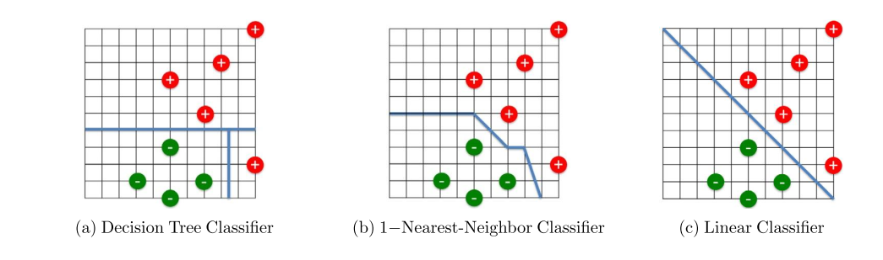
About Linear classifiers
Classifies generate complex decision boundaries.
Decision tree might generate hyperrectangular shape boundary
1-nearest neighbour classifier may generate hyper polygonal boundary
Linear classifier may general linear boundary
Better generalization performance, better interpretability
We discuss three classifiers: Linear regression, perceptron, logistic regression (widely used)

Slide 91


Linear Regression
Linear regression is a statistical technique that predicts a continuous value based on one or more independent attributes.
For example, we might want to predict the housing price based on the living
Since linear regression aims to predict a continuous value, it cannot be directly applied to the classification task, where the output is a categorical variable
Suppose we have n tuples, each of which is represented by p attributes
A continuous output value yi (i = 1,...,n). In linear regression, we want to learn a linear function that maps the p input attributes xi to the output variable yi, that is,
where yˆi is the predicted output value for the ith tuple, w = (w1, ...,wp)T is a p-dimensional weight vector and b is the bias scalar.
Algorithm: Least square regression, which aims to minimize the loss function. Therefore the best weight vector w and the bias scalar b are the ones that minimize the loss function L(w, b)

Slide 92
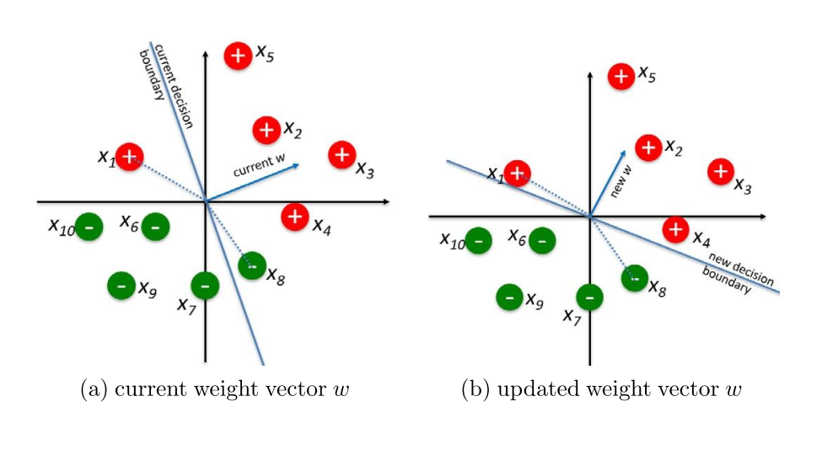
Perceptron
Consider a binary classification task
The output value yi for a given tuple is a binary variable: yi = +1 indicates the ith tuple is a positive tuple (e.g., buy computer) and yi = 0 indicates the ith tuple is a negative one (e.g., not buy computer).
Output of regression function is the sign of regression function
Sign=+1 if yi is the predicted class label, sign=0, otherwise
If we know the weight vector W, we can predict the class label.
W is interactively learned from the training set.
If the training tuples are linearly separable, the perceptron algorithm is guaranteed to find a weight vector (i.e., a hyperplane decision boundary)

Slide 93
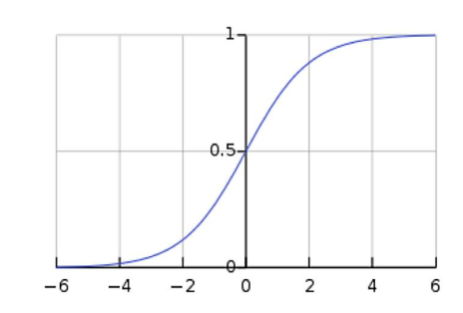
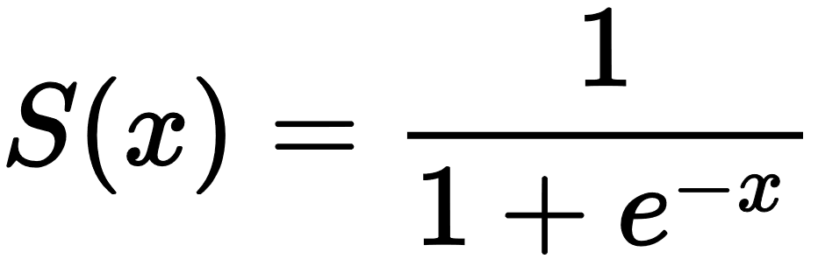
Logistic Regression
Perceptron predicts the binary class label of a given tuple. However, can we also tell how confident such a prediction is?
Logistic regression estimates the probability of an event occurring, such as voted or didn't vote, based on a given dataset of independent variables.
To convert the output from 0 to 1 sigmoid function is introduced.
Output of linear regression model is mapped to a number between 0 to 1
To determine optimal W vector, maximum likelihood estimation method is employed.
It aims to solve the following optimization problem: choosing the the best weight vector w that maximizes the likelihood of the training set.

Slide 94
Presentation Outline
Background
Basic concepts
Decision Tree Induction
Bayes Classification Methods
Lazy Learners
K-nearest neighbors
Case based reasoning
Linear Classifiers
Linear regression
Perceptron: turning linear regression to classification
Logistic regression
Model Evaluation and Selection
Techniques to Improve Accuracy
Summary

Slide 95
Model Evaluation and Selection
Evaluation metrics: How can we measure accuracy? Other metrics to consider?
Use validation test set of class-labeled tuples instead of training set when assessing accuracy
Methods for estimating a classifier’s accuracy:
Holdout method, random subsampling
Cross-validation
Bootstrap
Comparing classifiers:
Confidence intervals
Cost-benefit analysis and ROC Curves
95

Slide 96
Confusion Matrix
True positives (TP): These refer to the positive tuples that were correctly labeled by the classifier. Let TP be the number of true positives.
• True negatives (TN): These are the negative tuples that were correctly labeled by the classifier. Let TN be the number of true negatives.
• False positives (FP): These are the negative tuples that were incorrectly labeled as positive (e.g., tuples of class buys_computer = no for which the classifier predicted buys_computer = yes). Let FP be the number of false positives.
False negatives (FN): These are the positive tuples that were mislabeled as negative (e.g., tuples of class buys_computer = yes for which the classifier predicted buys_computer = no). Let FN be the number of false negatives.

Slide 97
Classifier Evaluation Metrics: Confusion Matrix
Confusion Matrix:
Actual class\Predicted class | C₁ | ¬ C₁
C₁ | True Positives (TP) | False Negatives (FN)
¬ C₁ | False Positives (FP) | True Negatives (TN)
Example of Confusion Matrix:
Actual class\Predicted class | buy_computer = yes | buy_computer = no | Total
buy_computer = yes | 6954 | 46 | 7000
buy_computer = no | 412 | 2588 | 3000
Total | 7366 | 2634 | 10000
Given m classes, an entry, CM_{i,j} in a confusion matrix indicates # of tuples in class i that were labeled by the classifier as class j
May have extra rows/columns to provide totals
97

Slide 98
Classifier Evaluation Metrics: Accuracy, Error Rate, Sensitivity and Specificity
A\P | C | ¬C
C | TP | FN | P
¬C | FP | TN | N
 | P’ | N’ | All
Class Imbalance Problem:
One class may be rare, e.g. fraud, or HIV-positive
Significant majority of the negative class and minority of the positive class
Sensitivity: True Positive recognition rate
Sensitivity = TP/P
Specificity: True Negative recognition rate
Specificity = TN/N
Classifier Accuracy, or recognition rate: percentage of test set tuples that are correctly classified
Accuracy = (TP + TN)/P+N
Error rate: 1 – accuracy, or
Error rate = (FP + FN)/P+N
98

Slide 99
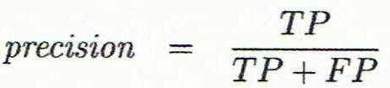
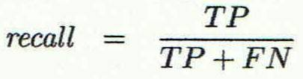
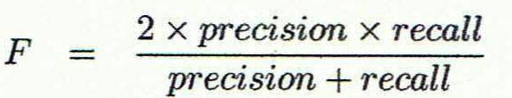
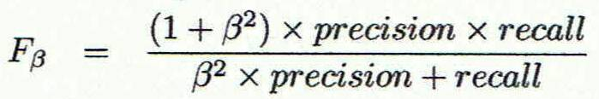
Classifier Evaluation Metrics: Precision and Recall, and F-measures
Precision: exactness – what % of tuples that the classifier labeled as positive are actually positive
Recall: completeness – what % of positive tuples did the classifier label as positive?
Perfect score is 1.0
Inverse relationship between precision & recall
F measure (F₁ or F-score): harmonic mean of precision and recall,
F_{ß}: weighted measure of precision and recall
assigns ß times as much weight to recall as to precision
99

Slide 100
Classifier Evaluation Metrics: Example
Actual Class\Predicted class | cancer = yes | cancer = no | Total | Recognition(%)
cancer = yes | 90 | 210 | 300 | 30.00 (sensitivity
cancer = no | 140 | 9560 | 9700 | 98.56 (specificity)
Total | 230 | 9770 | 10000 | 96.40 (accuracy)
Precision = 90/230 = 39.13% Recall = 90/300 = 30.00%
100

Slide 101
Evaluating Classifier Accuracy: Holdout & Cross-Validation Methods
Holdout method
Given data is randomly partitioned into two independent sets
Training set (e.g., 2/3) for model construction
Test set (e.g., 1/3) for accuracy estimation
Random sampling: a variation of holdout
Repeat holdout k times, accuracy = avg. of the accuracies obtained
Cross-validation (k-fold, where k = 10 is most popular)
Randomly partition the data into k mutually exclusive subsets, each approximately equal size
At i-th iteration, use D_{i} as test set and others as training set
Leave-one-out: k folds where k = # of tuples, for small sized data
*Stratified cross-validation*: folds are stratified so that class dist. in each fold is approx. the same as that in the initial data (popular method)
101

Slide 102

Evaluating Classifier Accuracy: Bootstrap
Bootstrap
Works well with small data sets
Samples the given training tuples uniformly with replacement
i.e., each time a tuple is selected, it is equally likely to be selected again and re-added to the training set
Several bootstrap methods, and a common one is .632 boostrap
A data set with d tuples is sampled d times, with replacement, resulting in a training set of d samples. The data tuples that did not make it into the training set end up forming the test set. About 63.2% of the original data end up in the bootstrap, and the remaining 36.8% form the test set (since (1 – 1/d)^{d} ≈ e⁻¹ = 0.368)
Repeat the sampling procedure k times, overall accuracy of the model:
102

Slide 103


Estimating Confidence Intervals: Classifier Models M₁ vs. M₂
Suppose we have 2 classifiers, M₁ and M₂, which one is better?
Use 10-fold cross-validation to obtain and
These mean error rates are just estimates of error on the true population of future data cases
What if the difference between the error rates is just attributed to chance?
Use a test of statistical significance
Obtain confidence limits for our error estimates
103

Slide 104
Estimating Confidence Intervals: Null Hypothesis
Perform 10-fold cross-validation
Assume samples follow a t distribution with k–1 degrees of freedom
Use t-test (or Student’s t-test)
Null Hypothesis: M₁ & M₂ are the same
If we can reject null hypothesis, then
we conclude that the difference between M₁ & M₂ is statistically significant
Chose model with lower error rate
104

Slide 105
Model Selection: ROC Curves
ROC (Receiver Operating Characteristics) curves: for visual comparison of classification models
Shows the trade-off between the true positive rate (TPR) and the false positive rate (FPR)
TPR is the proportion of positive (or “yes”) tuples that are correctly labeled by the model;
FPR is the proportion of negative (or “no”) tuples that are mislabeled as positive. Recall that T P, FP, P, and N are the number of true positive, false positive, positive, and negative tuples, respectively.
Rank the test tuples in decreasing order: the one that is most likely to belong to the positive class appears at the top of the list
The closer to the diagonal line (i.e., the closer the area is to 0.5), the less accurate is the model
Vertical axis represents TPR
Horizontal axis rep. the FPR
The plot also shows a diagonal line
A model with perfect accuracy will have an area of 1.0
105

Slide 106
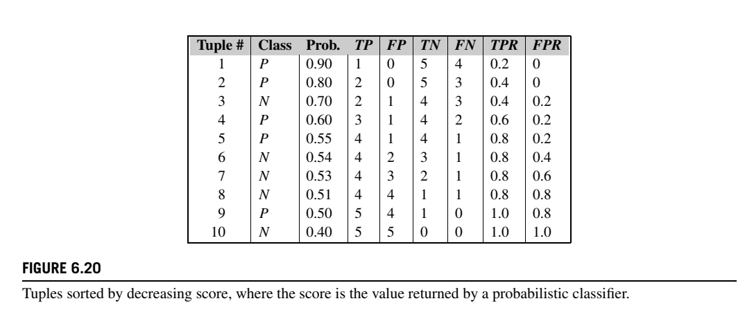
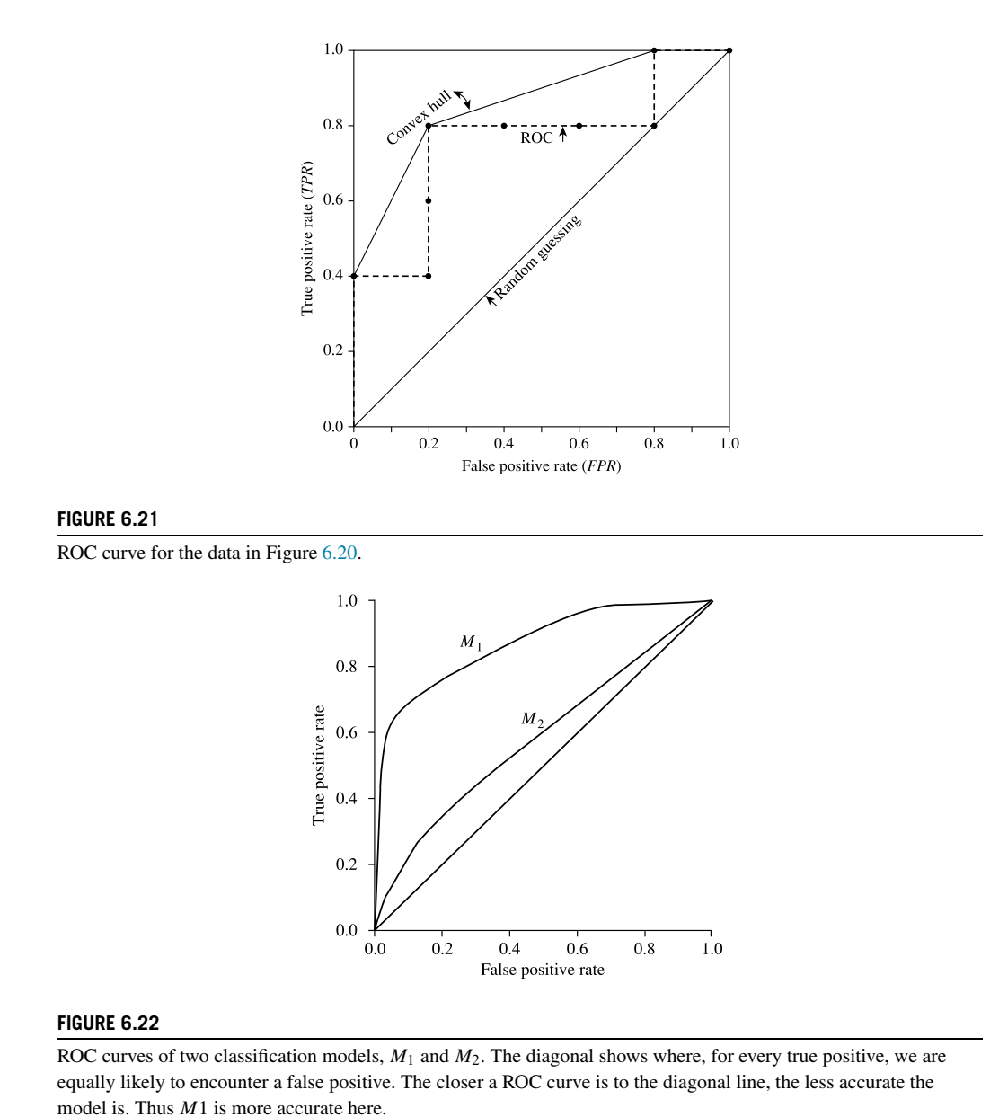

Slide 107
Issues Affecting Model Selection
Accuracy
classifier accuracy: predicting class label
Speed
time to construct the model (training time)
time to use the model (classification/prediction time)
Robustness: handling noise and missing values
Scalability: efficiency in disk-resident databases
Interpretability
understanding and insight provided by the model
Other measures, e.g., goodness of rules, such as decision tree size or compactness of classification rules
107
Notes:
107

Slide 108
Presentation Outline
Background
Basic concepts
Decision Tree Induction
Bayes Classification Methods
Rule-Based Classification
Model Evaluation and Selection
Techniques to Improve Accuracy
Summary

Slide 109
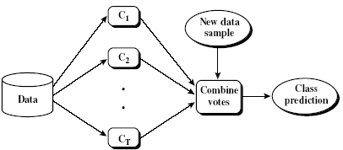
Ensemble Methods: Increasing the Accuracy
Ensemble methods
Use a combination of models to increase accuracy
Combine a series of k learned models, M₁, M₂, …, M_{k}, with the aim of creating an improved model M*
Popular ensemble methods
Bagging: averaging the prediction over a collection of classifiers
Boosting: weighted vote with a collection of classifiers
Ensemble: combining a set of heterogeneous classifiers
109

Slide 110
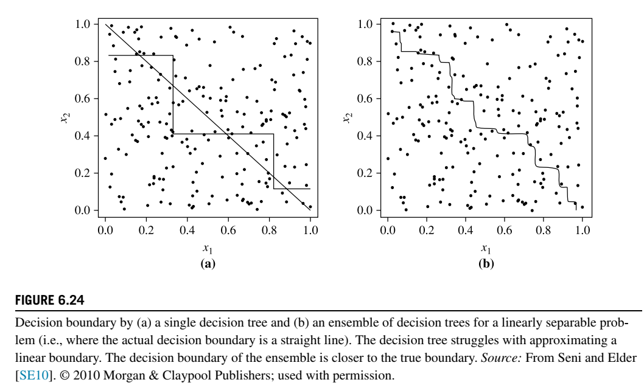

Slide 111
Bagging: Bootstrap Aggregation
Analogy: Diagnosis based on multiple doctors’ majority vote
Training
Given a set D of d tuples, at each iteration i, a training set D_{i} of d tuples is sampled with replacement from D (i.e., bootstrap)
A classifier model M_{i} is learned for each training set D_{i}
Classification: classify an unknown sample X
Each classifier M_{i} returns its class prediction
The bagged classifier M* counts the votes and assigns the class with the most votes to X
Prediction: can be applied to the prediction of continuous values by taking the average value of each prediction for a given test tuple
Accuracy
Often significantly better than a single classifier derived from D
For noise data: not considerably worse, more robust
Proved improved accuracy in prediction
111

Slide 112
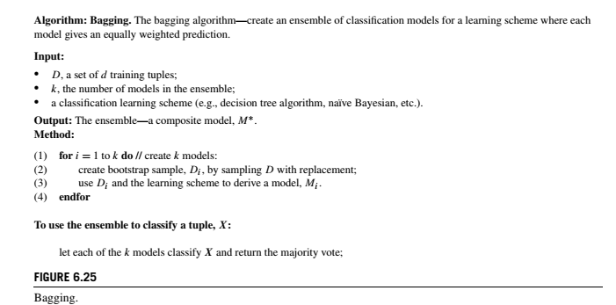

Slide 113
Boosting
Analogy: Consult several doctors, based on a combination of weighted diagnoses—weight assigned based on the previous diagnosis accuracy
How boosting works?
Weights are assigned to each training tuple
A series of k classifiers is iteratively learned
After a classifier M_{i} is learned, the weights are updated to allow the subsequent classifier, M_{i+1}, to pay more attention to the training tuples that were misclassified by M_{i}
The final M* combines the votes of each individual classifier, where the weight of each classifier's vote is a function of its accuracy
Boosting algorithm can be extended for numeric prediction
Comparing with bagging: Boosting tends to have greater accuracy, but it also risks overfitting the model to misclassified data
113

Slide 114
Adaboost (Freund and Schapire, 1997) Adaptive boosting
Given a set of d class-labeled tuples, (X₁, y₁), …, (X_{d}, y_{d})
Initially, all the weights of tuples are set the same (1/d)
Generate k classifiers in k rounds. At round i,
Tuples from D are sampled (with replacement) to form a training set D_{i} of the same size
Each tuple’s chance of being selected is based on its weight
A classification model M_{i} is derived from D_{i}
Its error rate is calculated using D_{i} as a test set
If a tuple is misclassified, its weight is increased, o.w. it is decreased
Error rate: err(X_{j}) is the misclassification error of tuple X_{j}. Classifier M_{i} error rate is the sum of the weights of the misclassified tuples:
The weight of classifier M_{i}’s vote is

Slide 115
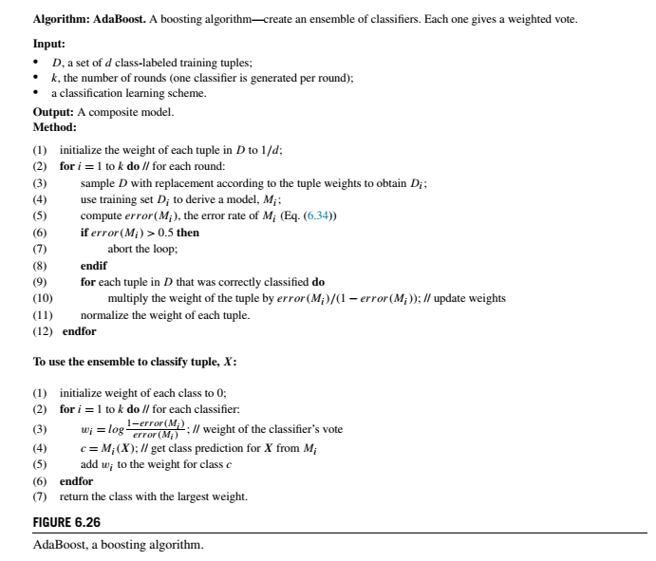

Slide 116
Gradient Boosting and XGboost
Gradient boosting is another powerful boosting technique, which can be used for classification, regression, and ranking.
If we use a tree (e.g., decision tree for classification, regression tree for regression) as the base model (i.e., the weak learner), it is called gradient tree boosting, or gradient boosted tree
A highly scalable end-to-end gradient tree boosting system is called XGBoost, which is capable to handle a billion-scale training set.
XGBoost has made a number of innovations for training gradient tree boosting, including a new tree construction algorithm designed for sparse data, feature subsampling (as opposed to training tuple subsampling in stochastic gradient boosting)
A highly efficient cacheaware block structure. XGBoost has been successfully used by data scientists in many data mining challenges, often leading to top competitive results.

Slide 117
Random Forest (Breiman 2001)
Random Forest:
Each classifier in the ensemble is a decision tree classifier and is generated using a random selection of attributes at each node to determine the split
During classification, each tree votes and the most popular class is returned
Two Methods to construct Random Forest:
Forest-RI (random input selection): Randomly select, at each node, F attributes as candidates for the split at the node. The CART methodology is used to grow the trees to maximum size
Forest-RC (random linear combinations): Creates new attributes (or features) that are a linear combination of the existing attributes (reduces the correlation between individual classifiers)
Comparable in accuracy to Adaboost, but more robust to errors and outliers
Insensitive to the number of attributes selected for consideration at each split, and faster than bagging or boosting
117

Slide 118
Classification of Class-Imbalanced Data Sets
Class-imbalance problem: Rare positive example but numerous negative ones, e.g., medical diagnosis, fraud, oil-spill, fault, etc.
Traditional methods assume a balanced distribution of classes and equal error costs: not suitable for class-imbalanced data
Typical methods for imbalance data in 2-class classification:
Oversampling: re-sampling of data from positive class so that the training set contains equal number of positive and negative samples.
Under-sampling: randomly eliminate tuples from negative class so that the training set contains equal number of positive and negative samples.
Threshold-moving: moves the decision threshold, t, so that the rare class tuples are easier to classify, and hence, less chance of costly false negative errors
Ensemble techniques: Ensemble multiple classifiers introduced above
Still difficult for class imbalance problem on multiclass tasks
118

Slide 119
Presentation Outline
Background
Basic concepts
Decision Tree Induction
Bayes Classification Methods
Rule-Based Classification
Model Evaluation and Selection
Techniques to Improve Accuracy
Summary

Slide 120
Summary (I)
Classification is a form of data analysis that extracts models describing important data classes.
Effective and scalable methods have been developed for decision tree induction, Naive Bayesian classification, rule-based classification, and many other classification methods.
Evaluation metrics include: accuracy, sensitivity, specificity, precision, recall, F measure, and F_{ß} measure.
Stratified k-fold cross-validation is recommended for accuracy estimation. Bagging and boosting can be used to increase overall accuracy by learning and combining a series of individual models.
120

Slide 121
Summary (II)
Significance tests and ROC curves are useful for model selection.
There have been numerous comparisons of the different classification methods; the matter remains a research topic
No single method has been found to be superior over all others for all data sets
Issues such as accuracy, training time, robustness, scalability, and interpretability must be considered and can involve trade-offs, further complicating the quest for an overall superior method
121

